Slide 1
Nepal:
The Test of Early Childhood Education
Shanta Dixit, Nepal
Right to Education and Early Childhood Education and Development, South Asian Perspective
16th- 17th September
Karachi

Slide 2
Nepal's commitment on International Forum
Universal Declaration of Human Rights 1948: Article 26
Declaration of the Rights of the Child 1959
International Covenant on Civil and Political Rights 1966
International Covenant on Economic, Social and Cultural Rights 1966: Articles 13 & 14
International Convention on the Elimination of all Forms of Racial Discrimination 1965
Minimum Age Convention 1973
Convention on the Elimination of all Forms of Discrimination against Women 1979
U.N. Convention on the Rights of the Child 1989 (Ratified: 14 September 1990)
Salamanca Declaration on Special Needs Education 1994
Worst Forms of Child Labour Convention 1999
Optional Protocols to the CRC on Sex Trafficking, Armed Conflict 2000
International Convention on the Rights of Persons with Disabilities – CRPD 2006 (Signed: 3 Jan 2008)

Slide 3
Interim Constitution of Nepal 2007
Article 17 (under part 3) - the fundamental rights- states that:
(1) Every community shall have the right to get basic education in its own mother tongue, as provided in law.
(2) Every citizen shall have the right to get free education up to the secondary level from the State, as provided in law.
(3) Every community residing in Nepal shall have the right to preserve and promote its language, script, culture, cultural civilization and heritage.
Article 22- Right of the Child states that:
(1) Every child shall have the right to have their own identity and name.
(2) Every child shall have the right to get nurtured, basic health and social security.
(3) Every child shall have the right against physical, mental or any other form of exploitation. The exploiting actions shall be punishable by the law and the person who is treated in such manner shall be compensated in accordance with the law.
(4) Helpless, orphan, mentally challenged, conflict victims, displaced and street kids at risk shall have the right to get special provision from the state for their secured future.
(5) Any minor shall not be employed in factories, mines or for any other hazardous work or shall be used in army, police or in conflicts.

Slide 4
The Government’s ECD related plans and policies are reflected in the Core Document for
Education for All National Plan of Action (EFA/NPA-2001-2015)
EFA 2004 – 2009
ECD Strategic Plan (2004)
Tenth Five Year Plan (2002-07)
Ninth Five Year Plan (1998-2002)
Local Self-Governance Act (1999)
Basic and Primary Education Master Plan (1997-2002)
Ten Year National Program of Action for Children and Development (1992)

Slide 5
The Right to Education component concerning ECD is covered in
Education for All National Plan of Action (EFA/NPA-2001-2015, long term) – Goal 2
Thirteenth Plan (2013-15) National Planning Commission
Out of School Strategy Paper (2013-2015), FCBE 1093 VDCs, 13 districts – Pilot FCE
Education Sector Plan: School Sector Reform Program (2009-15) – Component 2
EFA Core Document (2004-09, medium term) – Goal 2
Community School Support Program (CSSP, 2003- 2009) – Contributes to FCE
Construction of Primary Schools (EFA 04-09; JICA, 03-06) - Contributes to FCE
Teacher Education Project (TEP, 02-07) - Contributes to FCE
Literacy/NFE Policy and Program Framework – Related with FCE
Various Programs of UN agencies, such as UNICEF, UNESCO, UNDP, WFP, ILO
Various programs of I/NGOs such as Save the Children, Plan Nepal, World Education, World Vision are contributing to FCE of Nepal

Slide 6
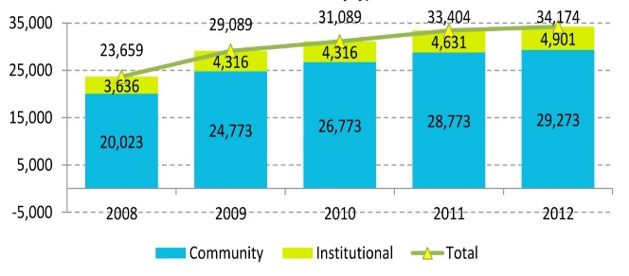
ECED Centers over 5 years

Slide 7
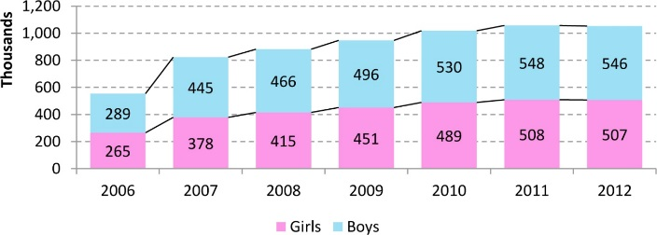
Enrolment Trends according to Gender

Slide 8
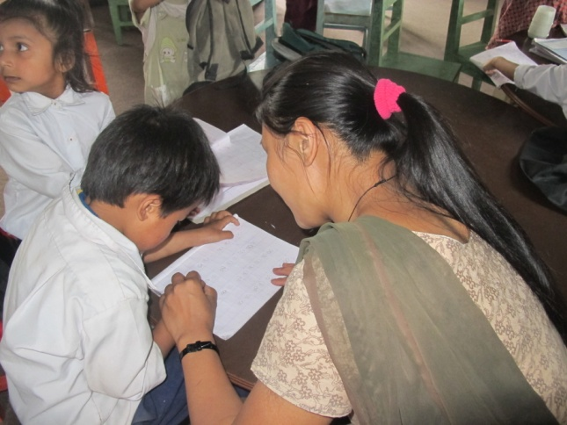

Slide 9
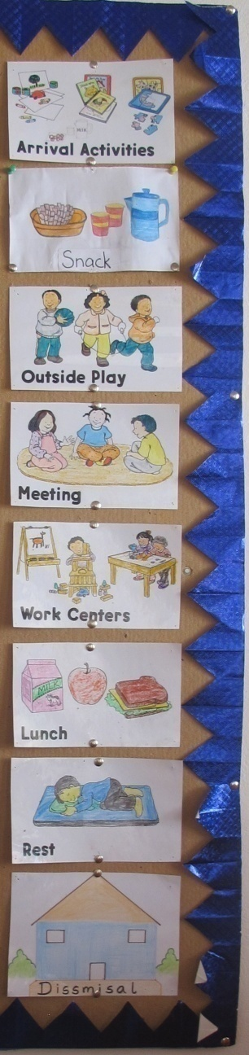
Schedule
TIME | K1 | K2
8:45 – 9:15 | Arrival | Arrival in class
9:15 – 9:40 | Morning meeting | Work Center
9:40 – 10:00 | Refreshment | Refreshment
10:00 - 10:40 Assistant…….. | Work center(math/eng) Diku / Situ | Outdoor(nursery didi)
10:40 - 11:20 | Outdoor | Work center
11:20 - 11:50 | Work center (science/social) | Morning meeting
11:50 – 12:20 | Lunch | Lunch(kitchen didi)
12:20 – 12:45 | Rest | Rest
12:45 – 1:00 | Fruits | Fruit
1:00 – 1:40 Assistant……. | Work centre(math/ eng) Diku / Situ | Lib/painting/art craft/sand/rainbow rice/outdoor/manipulative/beads/ Geoboard/water
1:40 – 2:15 | Lib/painting/art craft/sand/rainbow rice/outdoor/manipulative/beads/ Geoboard | Work center(science/social)
2:15 – 2:30 | Snack | Snack
2:30 2:45 | Dismissal | Dismissal

Slide 10
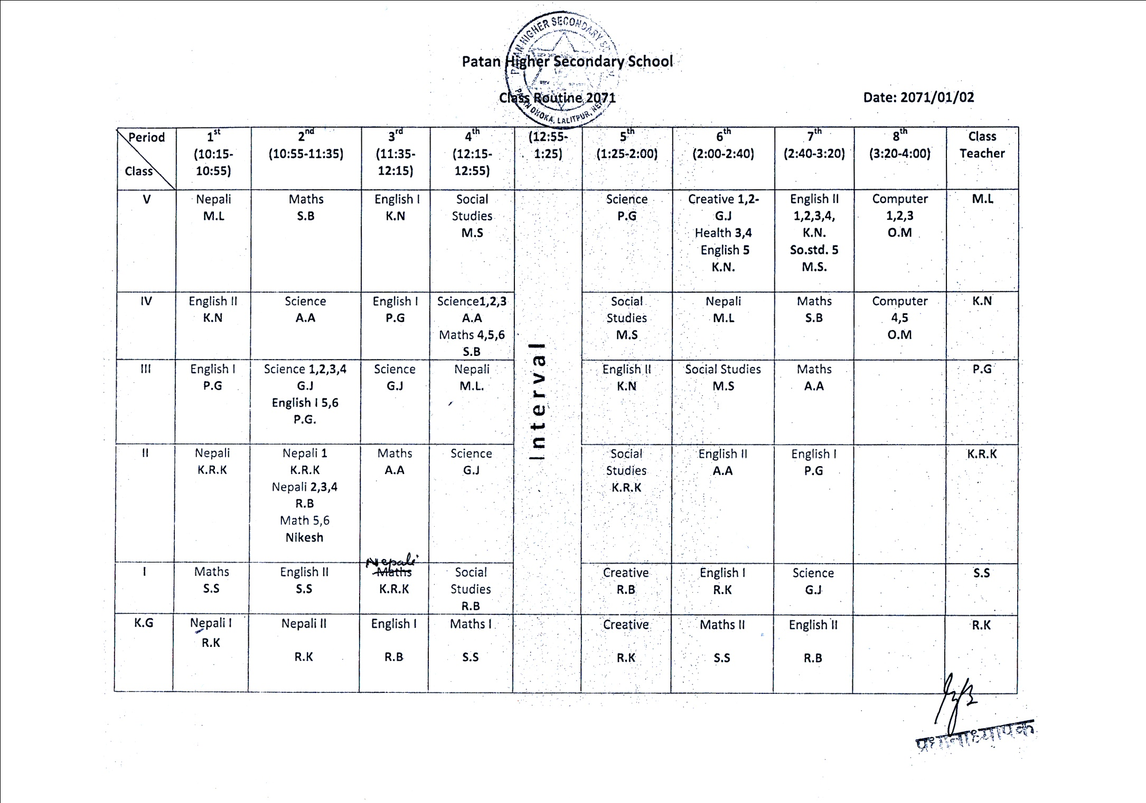
Schedule for Primary Grades, including K.G., which is ECD
for Nepal

Slide 11
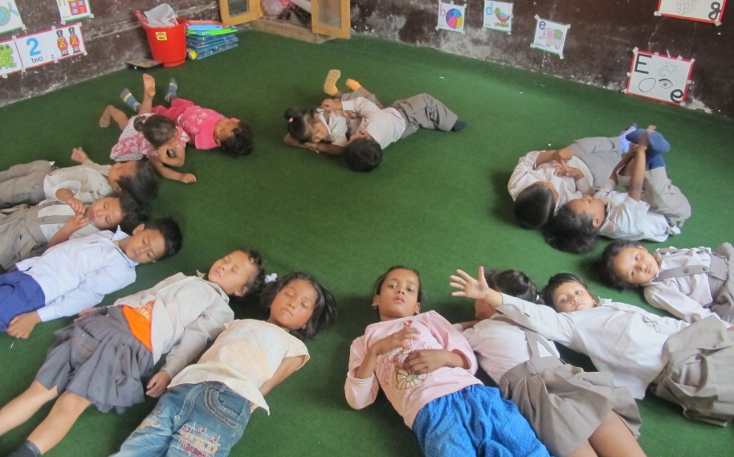
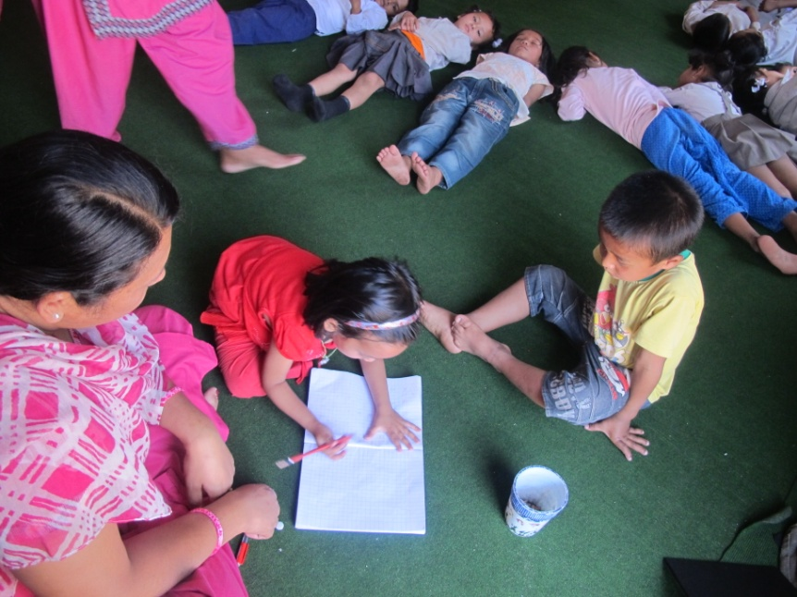
Classroom Management
Children lie down making a circle with their heads, and their bodies radiate out.
One child is being taught to write wile others are expected to rest. They are curious, but afraid to enquire. There is no furniture in this ECD class

Slide 12
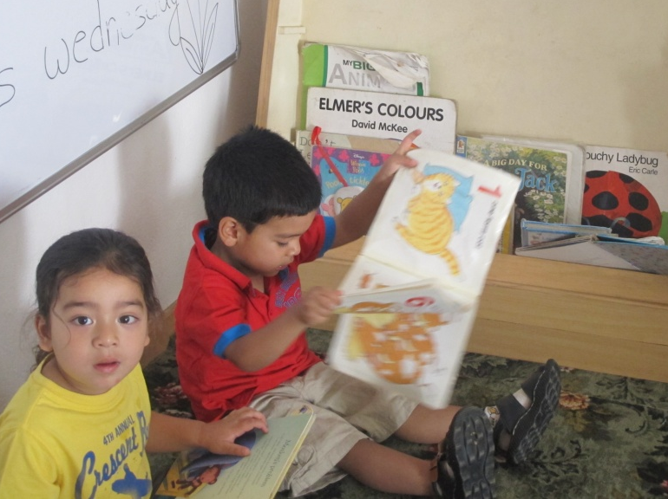
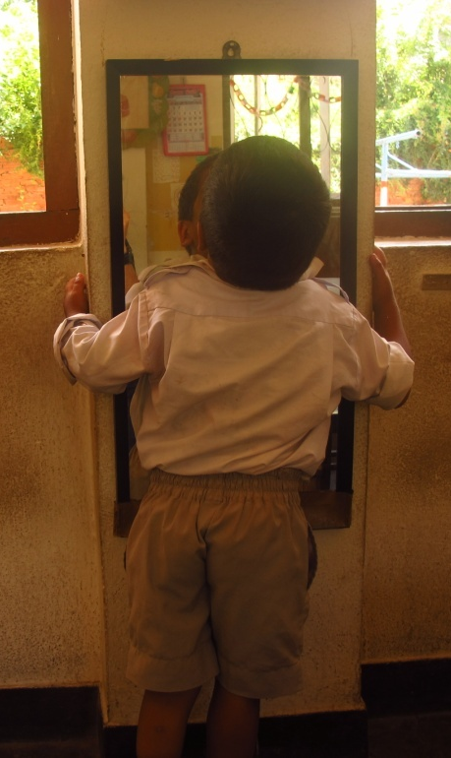
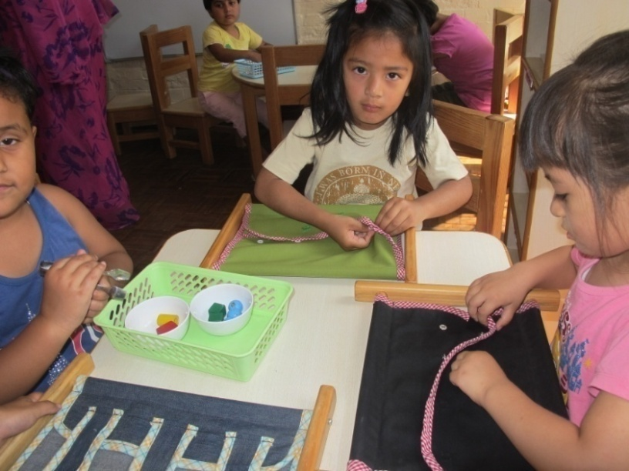
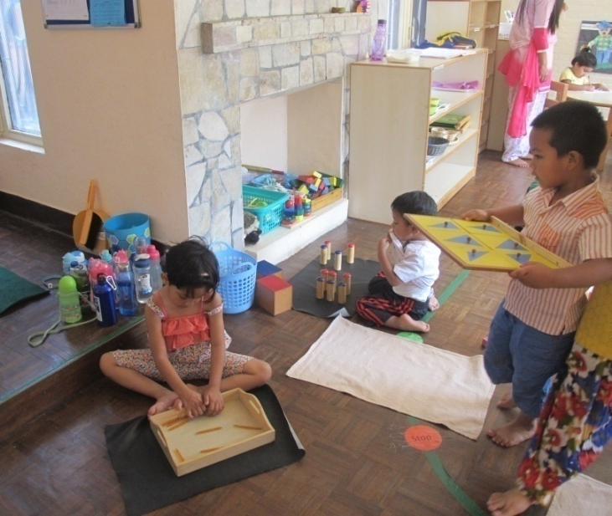
Children are free to explore and learn at their pace. Teachers are facilitators and guides.

Slide 13
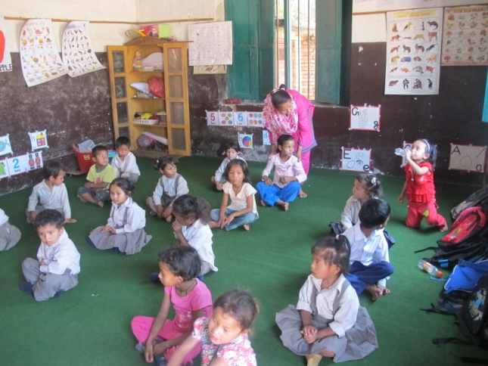
Time on Task:
Students sit purposefully and wait for the teacher to give them, one after another, water from the bottle they have brought from home
violating the teaching adage: Teachers must not do what children can do.
This activity took 19 minutes.

Slide 14
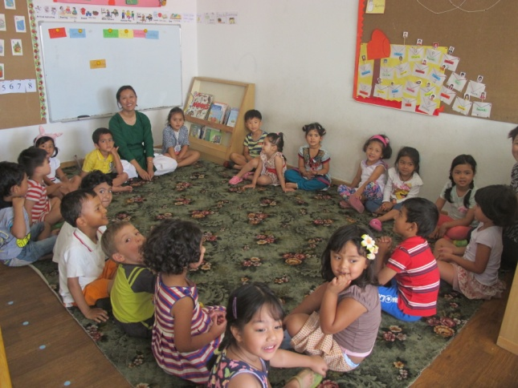
Meeting in private ECD where children were making plans with the teacher about going and studying plant in the local nursery as part of their curriculum on plants. Here they stop to greet a visitor

Slide 15
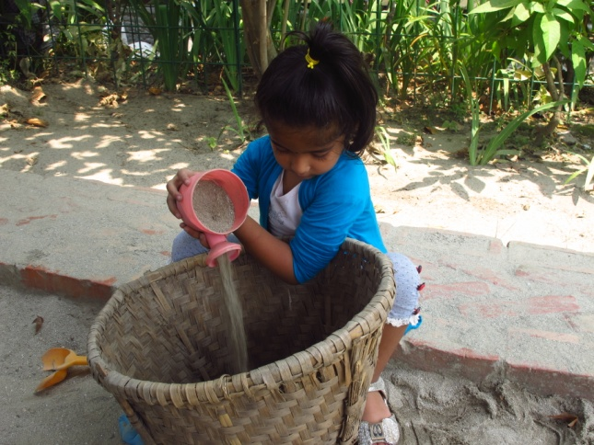
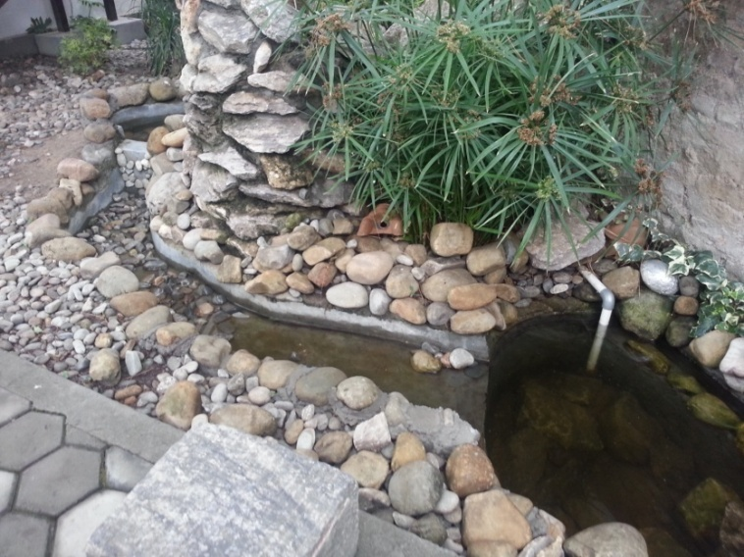
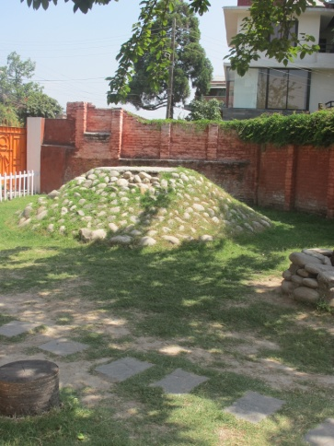
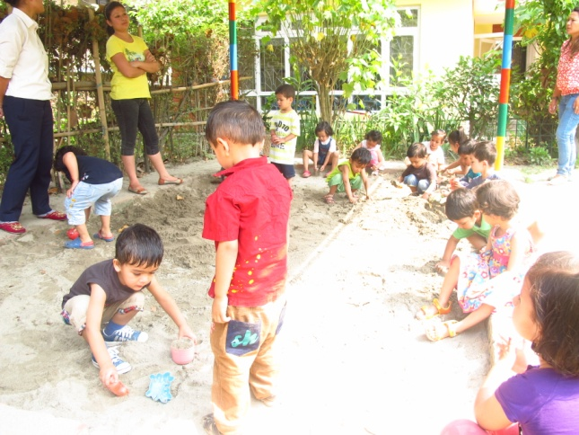
Physical Activity
Outdoor experience and trips are essential elements of private schools.

Slide 16
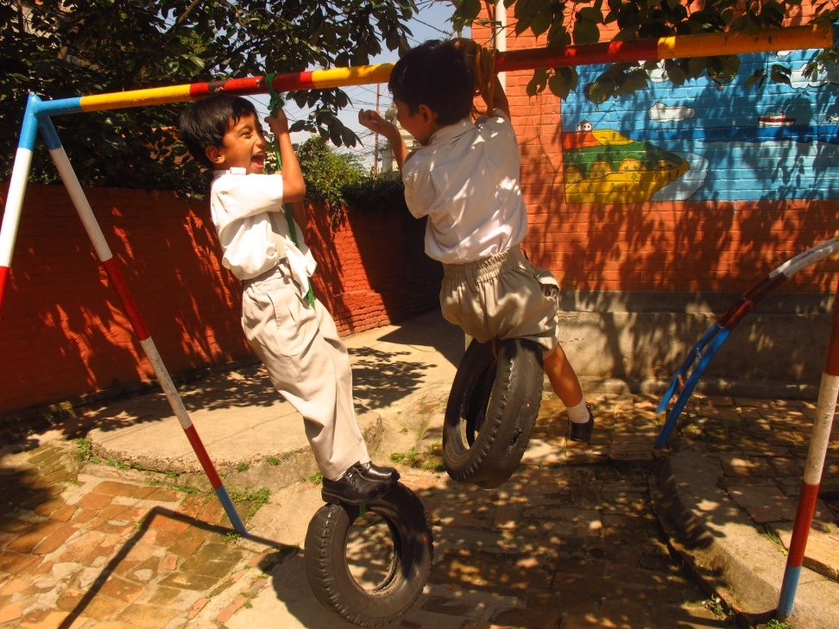
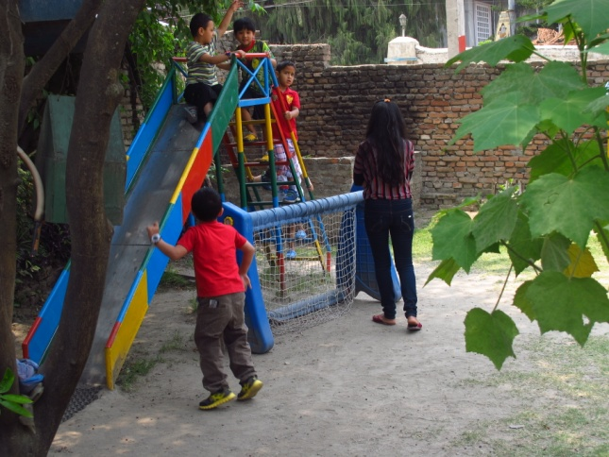
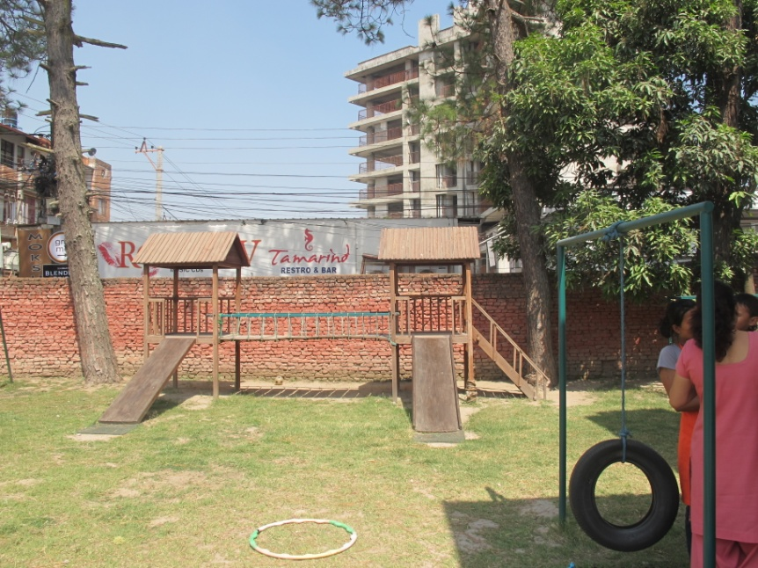
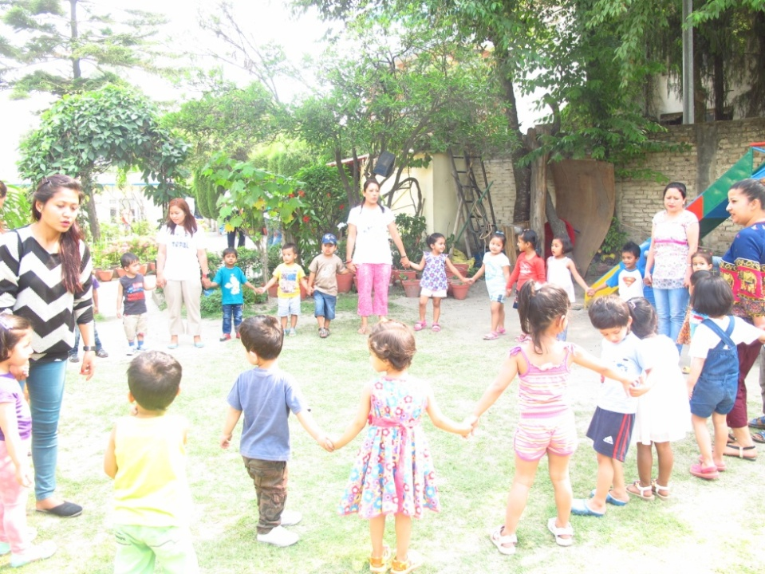

Slide 17
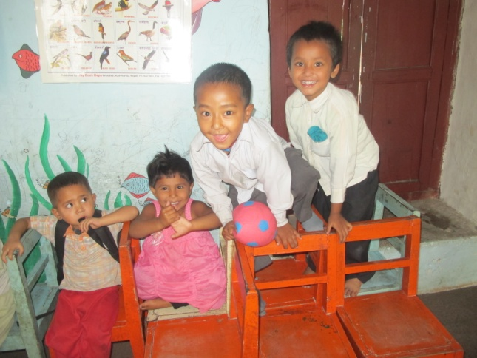
Public school children never get to go outdoors, no matter how well resourced the in terms of outdoor space.

Slide 18
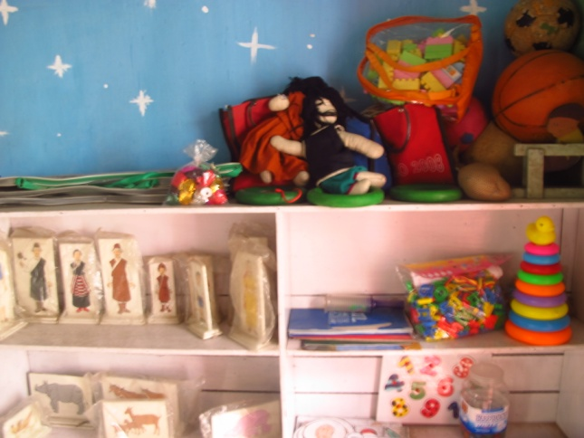
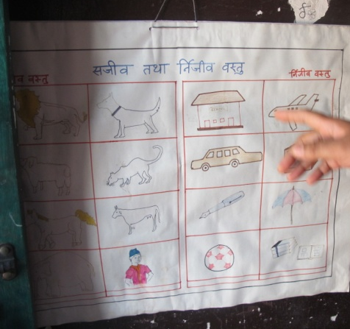
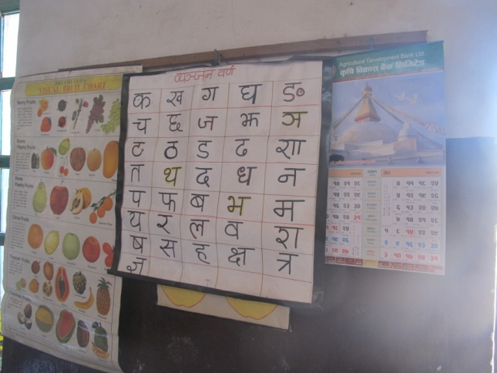
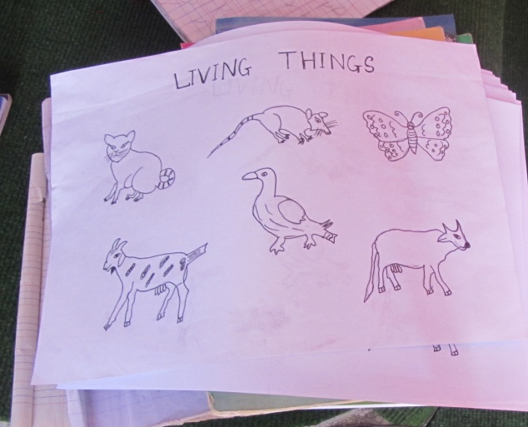
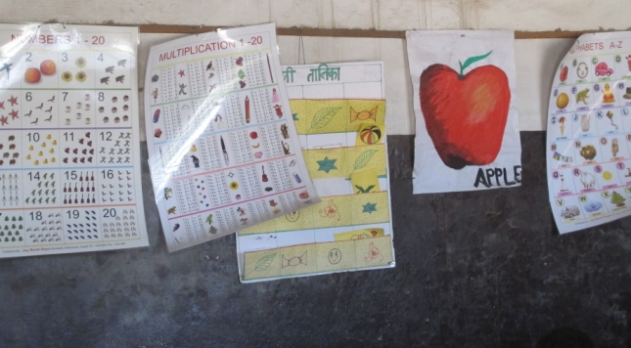
Teaching Material
Public schools lack teaching resources. Even when they exist, they are mostly shelved, with the fear that they might be ruined.

Slide 19
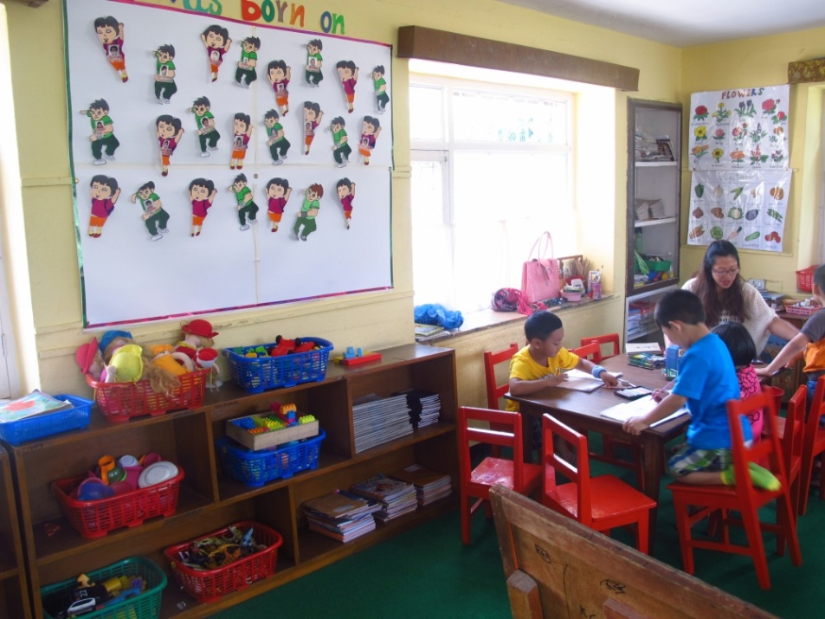
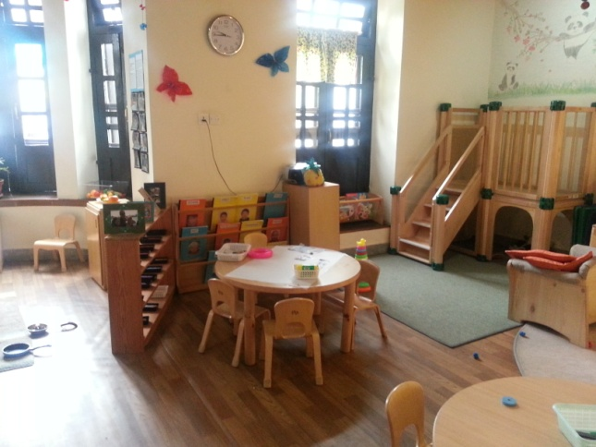
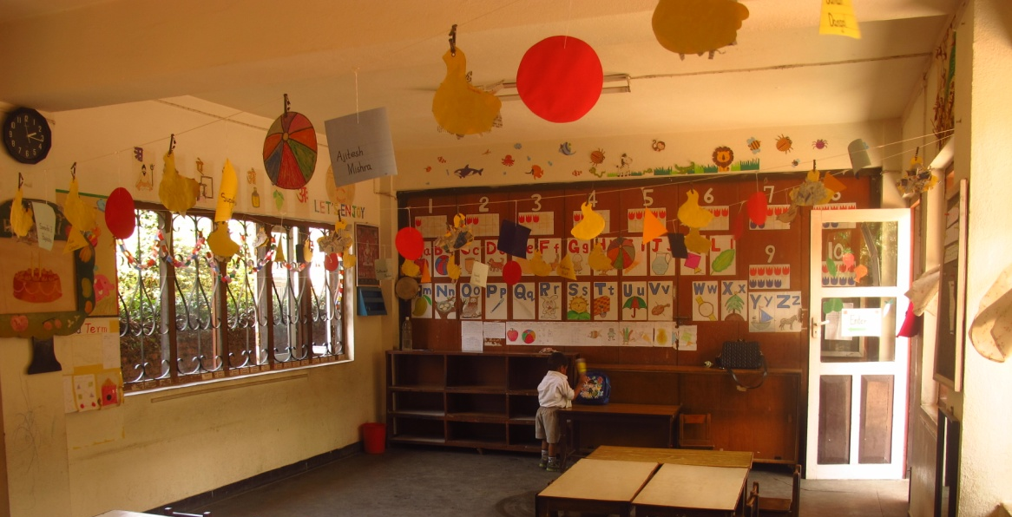
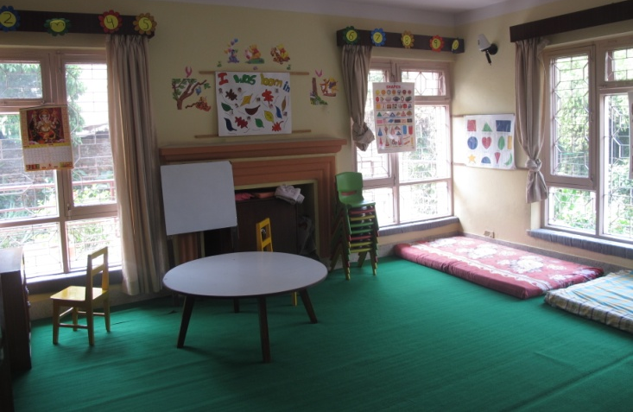
In the private schools…

Slide 20
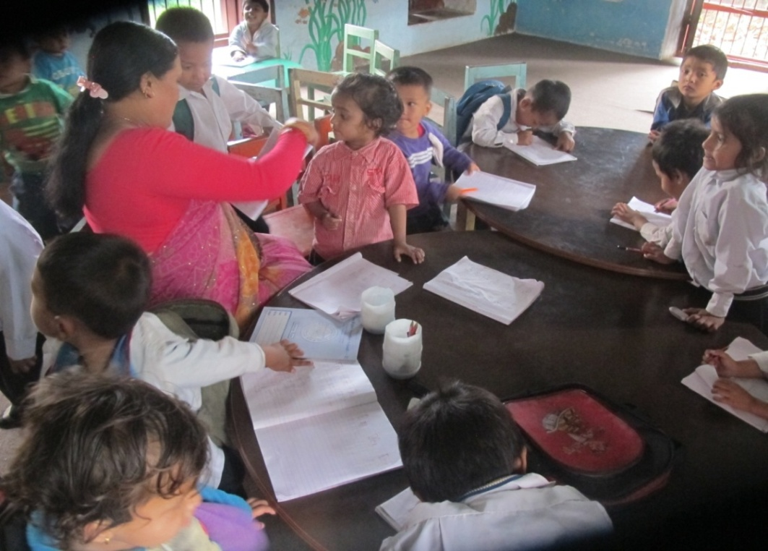
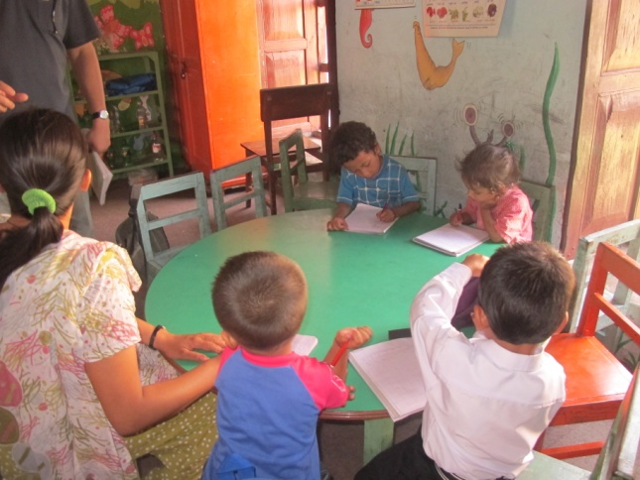
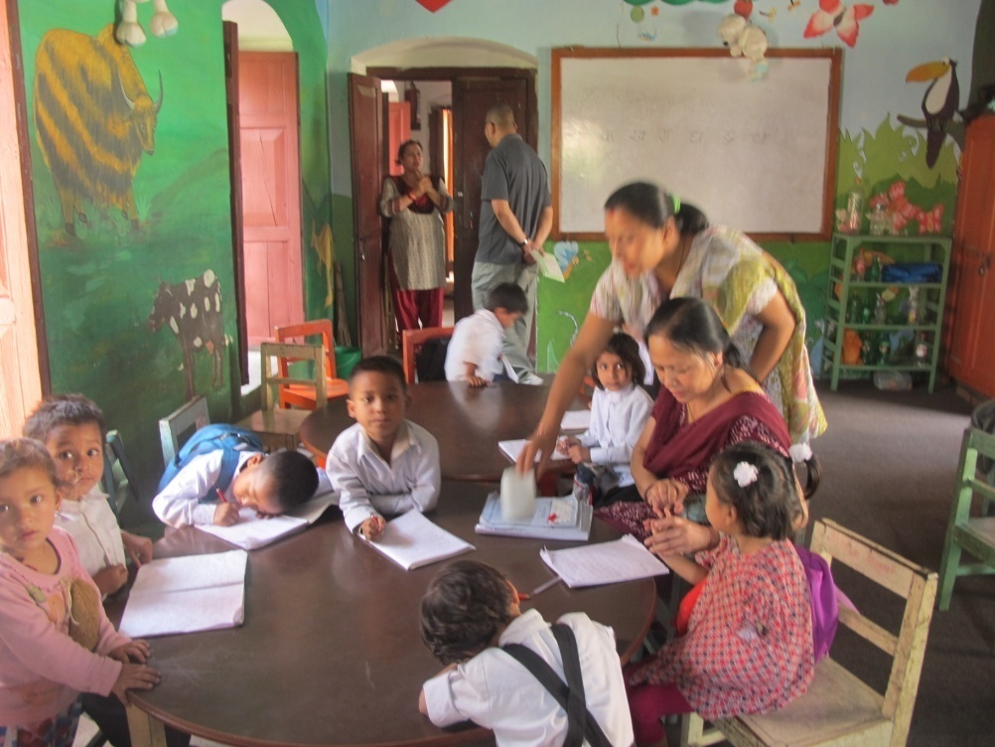
Implementing the Curriculum
Teachers sincerely follow the schedule: One period writing, the other period reading about what the children have written very well. Even when there are two teachers, they do more of the same.

Slide 21
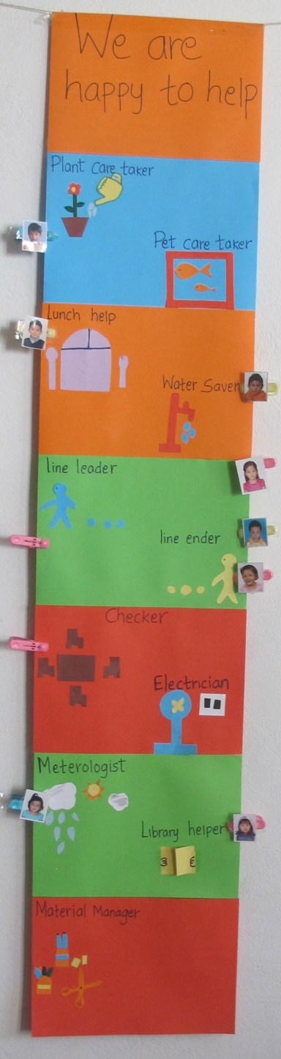
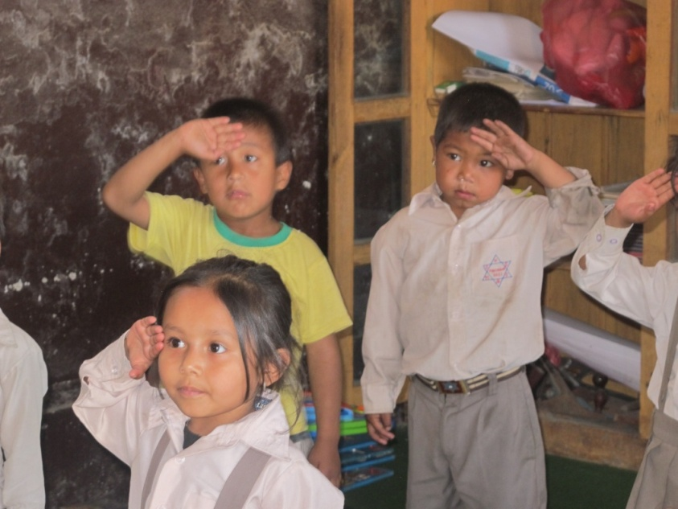
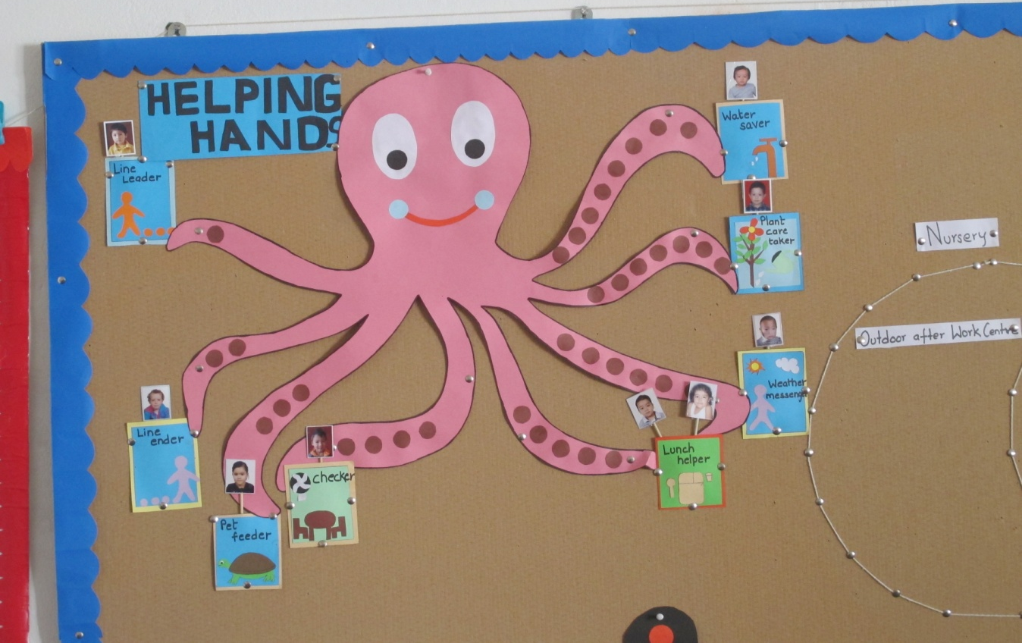
Foster Responsibility:
Private schools give responsibilities to students. The students in public schools learn to be obedient from very early age.

Slide 22
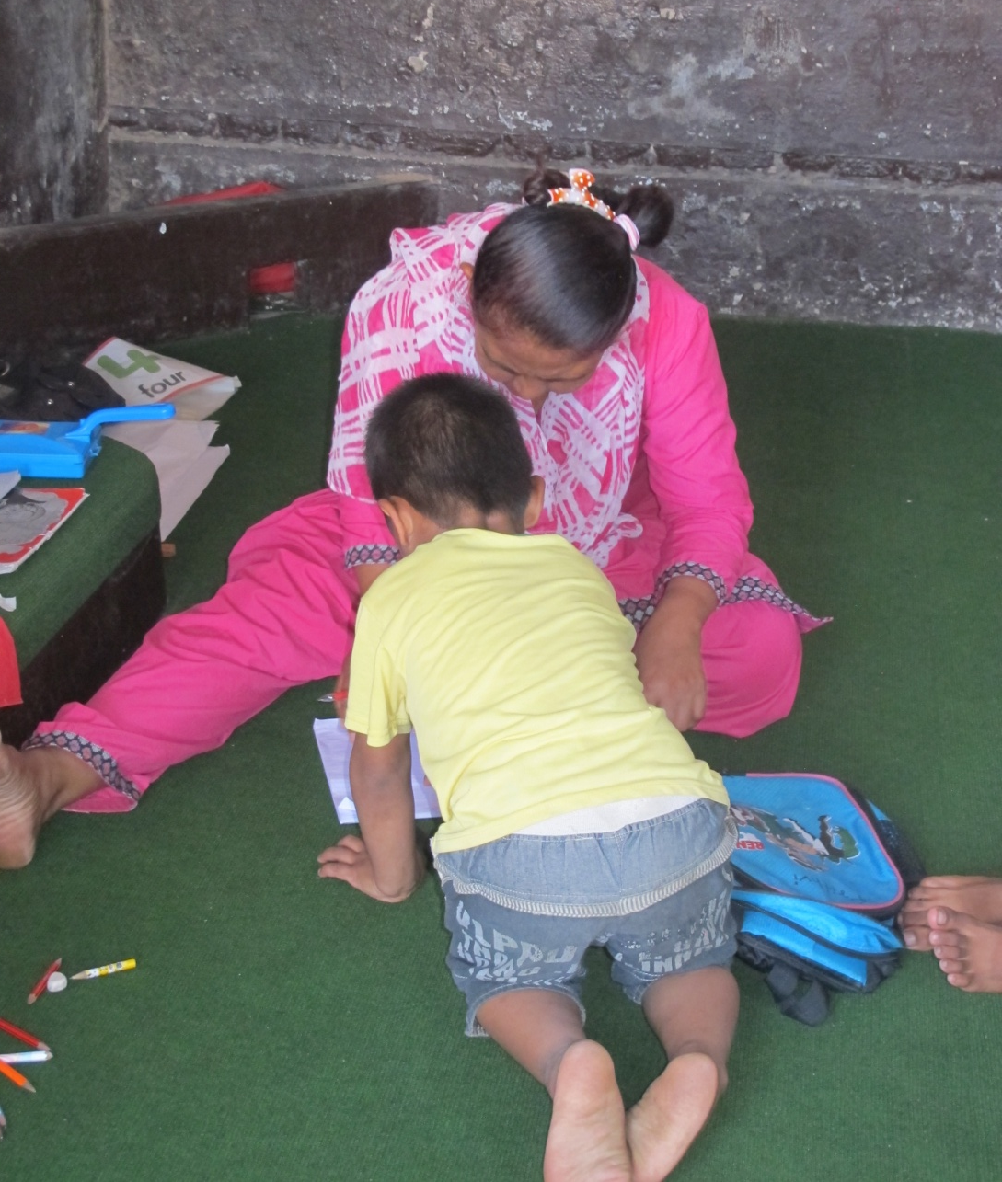
Teacher Preparation:
One on one attention is limited to hand-holding and making children write. The two to five day one time training for pre-schools without any follow up is not working.

Slide 23
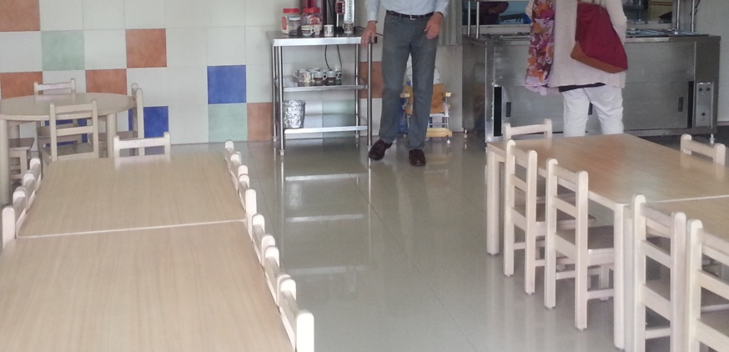
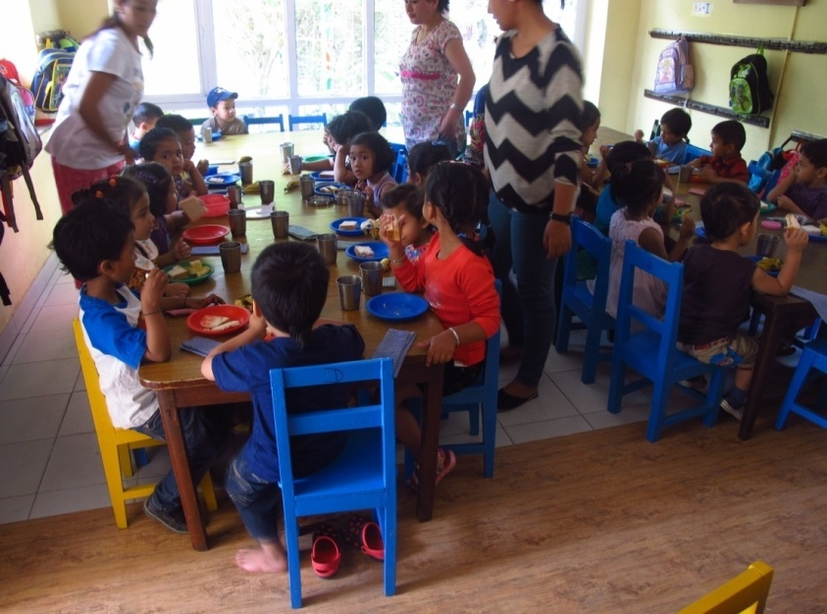
brought from home
Food
Private schools provide shacks and lunch. Those going to public schools eat food they bring from home

Slide 24
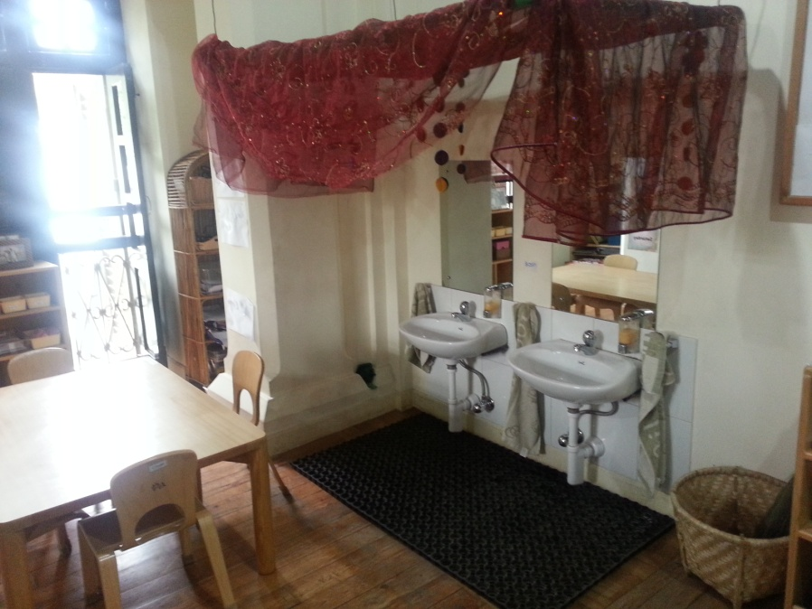
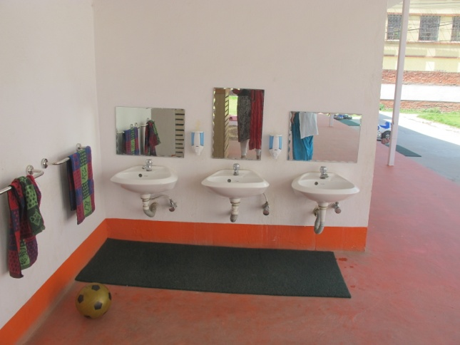
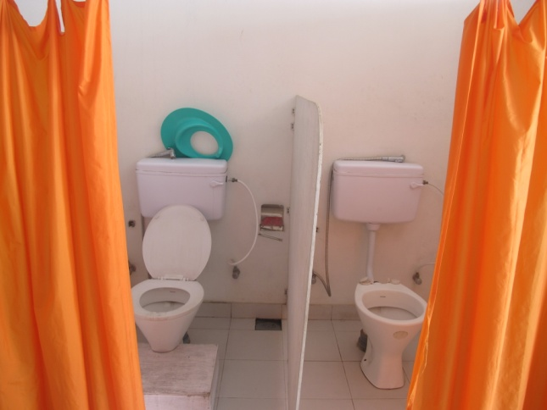
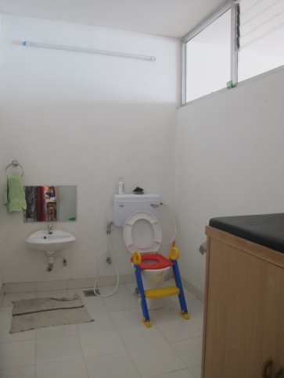
Toilet
The public school students have to negotiate toilets that might be available in the school

Slide 25
What do you consider the success of your ECD Program?
If the students are prepared to deal with the study in Grade I.
If the students start listening to us and doing what we tell them.
Our success is in getting the children ready for grade I. By the time they finish, they read and write in English and Nepali. Their overall growth is good, they are happy.
Children's happiness, they accomplish the important curriculum goals such as exercise in practical skills, individual personality development, and internal motivation.
Seeing growth in the individual child, witnessing them making the connection and learning. Having a waiting list of students wanting to come into my school.
Safe and happy kids. Safety covers all areas, including parenting and teaching. Bad teaching is unsafe for children. Good communication with parents.

Slide 26
Violation of child’s rights basic rights have are observed in large and popular public schools in the capital.
  Physiological needs: food, toilet, physical activity
  Safety needs: threat from friends, from adults, and from environment
  Belongingness and Love: a case of “us” and “them”, particularly from teachers, team spirit not taught.
  Self esteem: low as very little skill is developed.
  Cognition: no training of teachers (only 2 or 5 day training), so teachers generally do not understand the needs of the ECD child. Teachers have a false sense of accomplishment. Little knowledge…

Slide 27
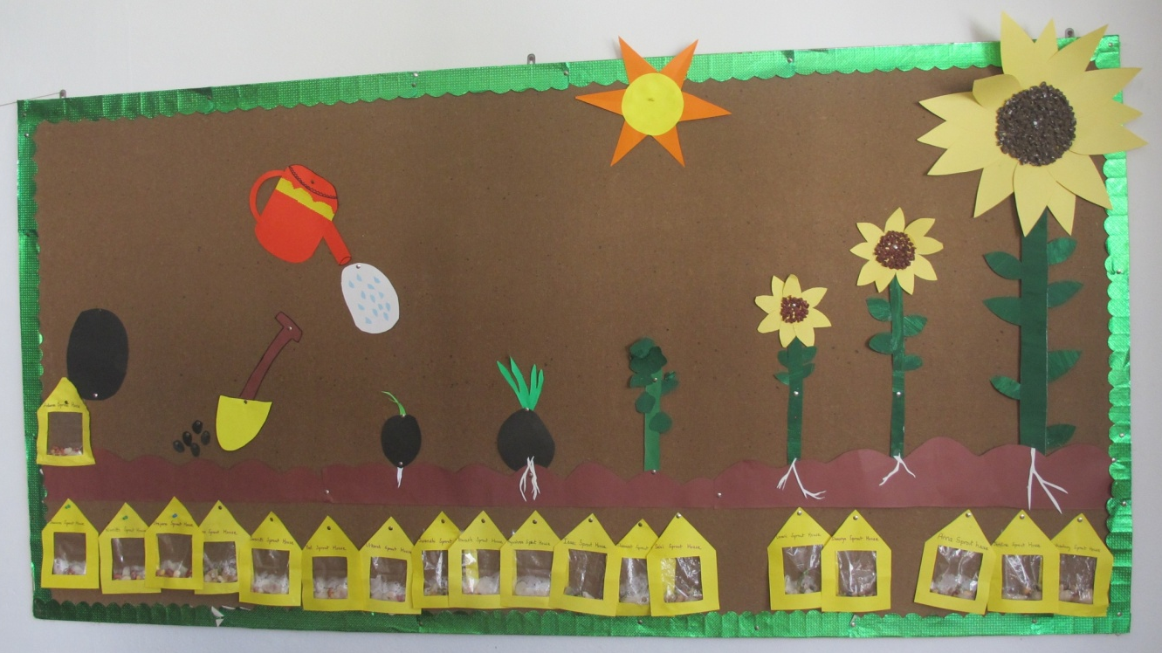
Germination
Using this analogy, of 3 year olds study of germination, how will our children develop? Do they have the nutrient required for their brain?
Proper ECD programs should be packaged well, and given to all whether or not they have the ability to pay. In this lies the future of every country.

